Slide 1
COMMENTS CLASSIFIER PROJECT
presented by
Ashin Dileep t p

Slide 2
Contents
Problem Statement
Objective
Libraries Used
Loading Data
Data Description
Exploratory Data Analysis
Data Pre-processing
Model Training And Testing
Saving Model
Predicting comments classes on Test dataset

Slide 3
Problem Statement
The proliferation of social media enables people to express their opinions widely online. However, at the same time, this has resulted in the emergence of conflict and hate, making online environments uninviting for users. Although researchers have found that hate is a problem across multiple platforms, there is a lack of models for online hate detection.
Online hate, described as abusive language, aggression, cyberbullying, hatefulness and many others has been identified as a major threat on online social media platforms. Social media platforms are the most prominent grounds for such toxic behaviour.
There has been a remarkable increase in the cases of cyberbullying and trolls on various social media platforms. Many celebrities and influences are facing backlashes from people and have to come across hateful and offensive comments. This can take a toll on anyone and affect them mentally leading to depression, mental illness, self-hatred and suicidal thoughts.

Slide 4
Internet comments are bastions of hatred and vitriol. While online anonymity has provided a new outlet for aggression and hate speech, machine learning can be used to fight it. The problem we sought to solve was the tagging of internet comments that are aggressive towards other users. This means that insults to third parties such as celebrities will be tagged as unoffensive, but “u are an idiot” is clearly offensive.
Our goal is to build a prototype of online hate and abuse comment classifier which can used to classify hate and offensive comments so that it can be controlled and restricted from spreading hatred and cyberbullying.

Slide 5
The Objective for the Problem Undertaken
Our goal is to build a prototype of online hate and abuse comment classifier which can be used to classify hate and offensive comments so that it can be controlled and restricted from spreading hatred and cyberbullying.

Slide 6
Required Libraries
Pandas
Numpy
Matplotlib
Seaborn
Scipy
NLTK
wordcloud
Sklearn
Joblib

Slide 7
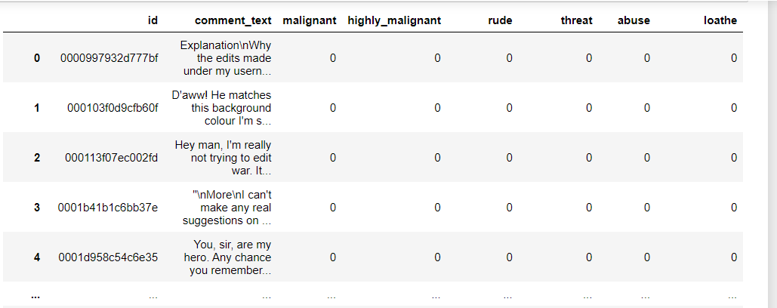
Loading Data (Training Data)

Slide 8
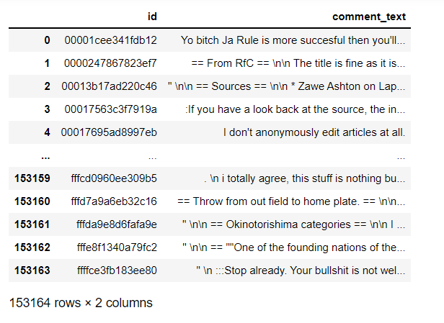
Loading Data (Test Data)

Slide 9
Data Description
The data set contains the training set, which has approximately 80814 samples and the test set which contains 1,53,164 samples. All the data samples contain 8 fields which includes ‘Id’, ‘Comments’, ‘Malignant’, ‘Highly malignant’, ‘Rude’, ‘Threat’, ‘Abuse’ and ‘Loathe’.
The label can be either 0 or 1, where 0 denotes a NO while 1 denotes a YES. There are various comments which have multiple labels. The first attribute is an unique ID associated with each comment.

Slide 10
Visualizations / Exploratory Data Analysis
DISCLAIMER: The slides contains text that may be considered profane, vulgar, or offensive.

Slide 11
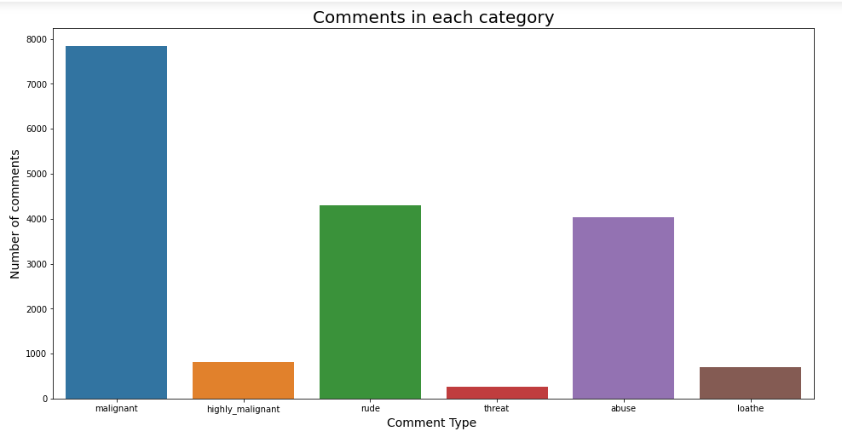
Number of comments under each label.

Slide 12
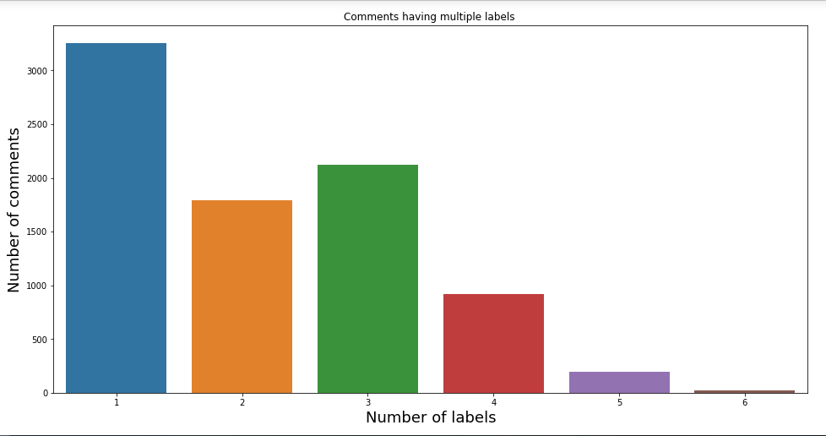
Number of comments having multiple labels.

Slide 13
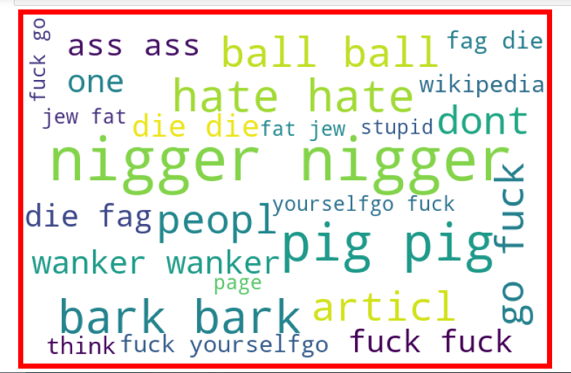
Cloud words in malignant comments.

Slide 14
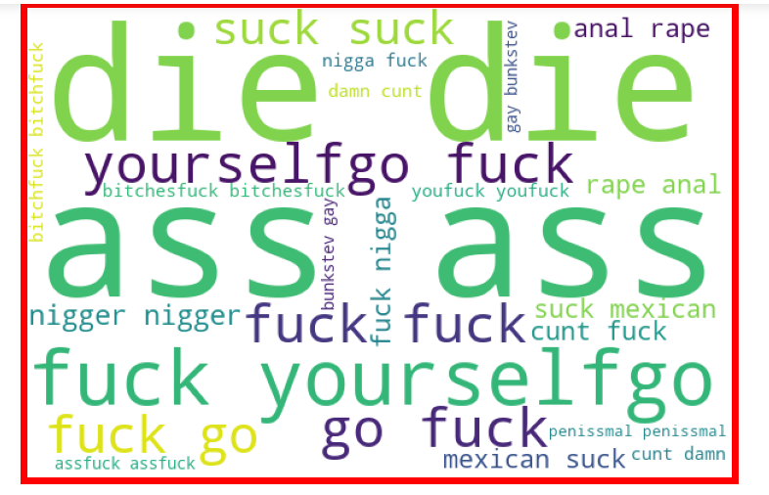
Cloud words in highly_malignant comments.

Slide 15
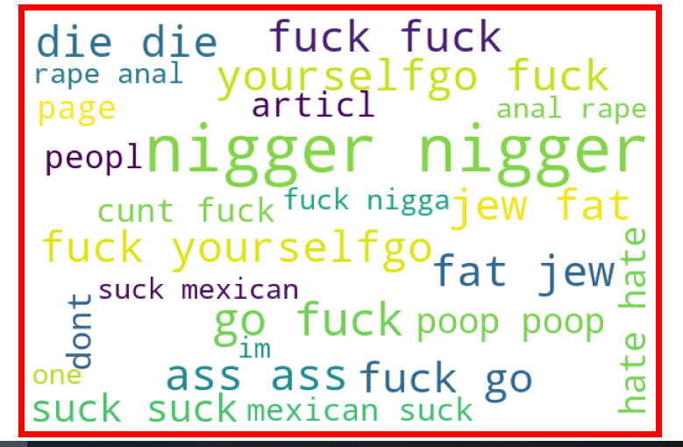
Cloud words in rude comments.

Slide 16
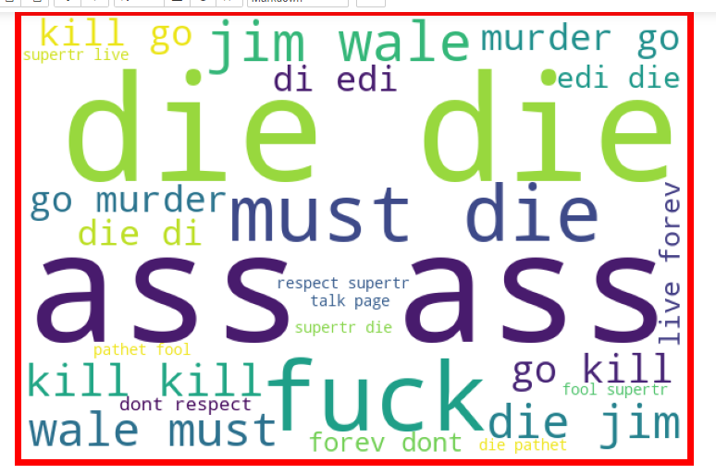
Cloud words in threat comments.

Slide 17
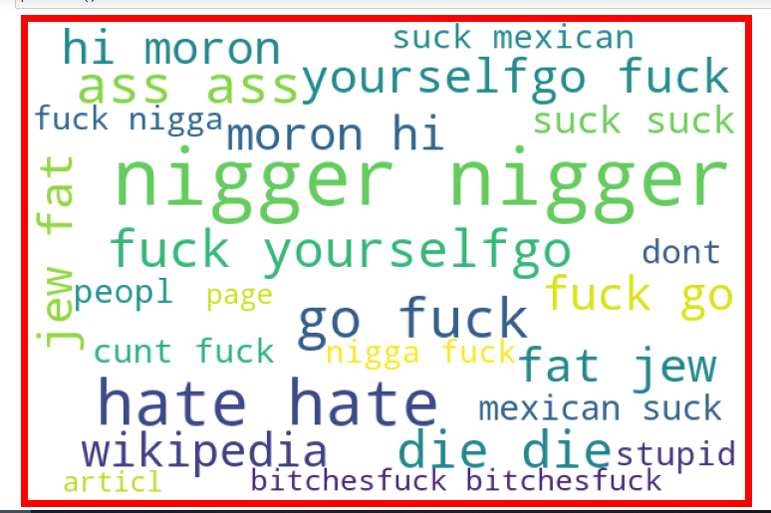
Cloud words in abuse comments.

Slide 18
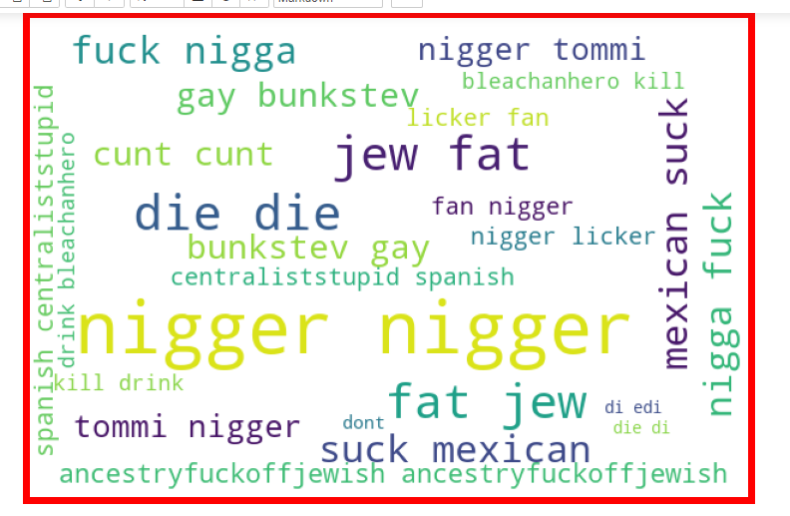
Cloud words in loathe comments.

Slide 19
Data Pre-Processing

Slide 20
Certain label columns had text data other than 0 and 1 hence those data were replaced with NaN values. And some values i.e., 0 and 1 were in string format i.e., ‘0’ and ‘1’ hence those data were replaced with 0 and 1 values.
The dataset has missing values in it. Since those NaN values were not in huge numbers, those values were dropped from the dataset.
Then ‘emojis’ present in the comments were eliminated, all the comments were converted to lower case, replaced 'numbers' present in the comments with 'space', removed all the punctuations present in the comments, replaced 'wide-space' between terms/words with a ‘single space’, removed underscores, removed leading and trailing ‘wide-space’.Then converted label columns into ‘int’ Dtype.

Slide 21
After that removed 'stop words' and then stemmed words using Porter Stemmer.
After that the text (the comments) were converted into features using Tf-idf Vectorizer Model.
Same methods are used to clean the test dataset. After that ‘set functions’ has been used to retain only those features which have been used to train the model i.e., dropped features which are not used to train and test the models from test dataset and added features which were used in training and testing the models.

Slide 22
Model Training And Testing

Slide 23
Selected Algorithms
Logistic Regression
SGD Classifier
K Neighbors Classifier
Decision Tree Classifier
Random Forest Classifier

Slide 24
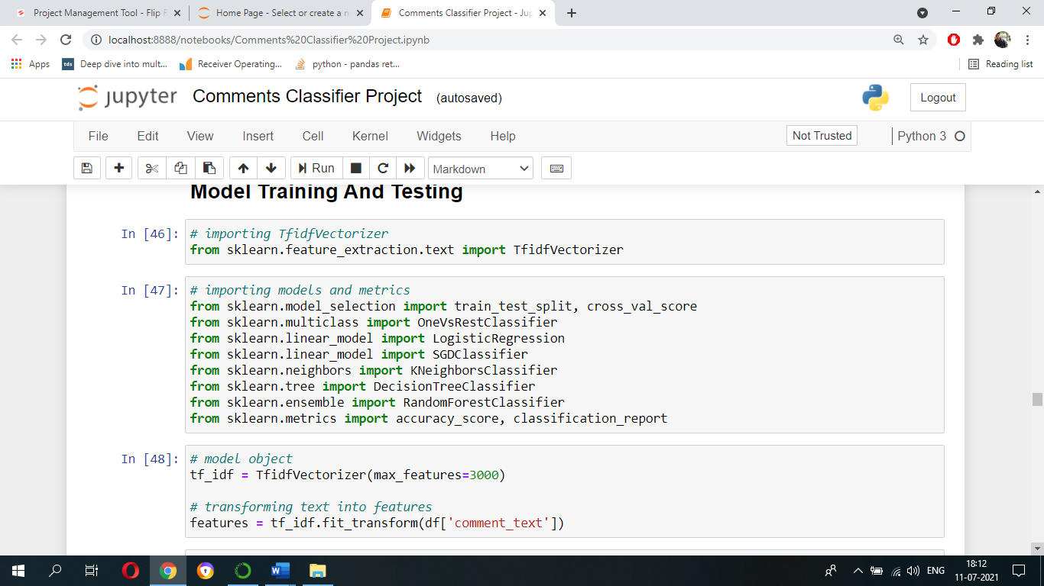
Importing Algorithms

Slide 25
Before using machine learning algorithms/models we should always split our data into a training set and testing set.
Let’s split our data into train set and test set using ‘train_test_split’ function. We can import train_test_split function from sklearn.model_selection. Let the test size be 25% and remaining 75% be train set.

Slide 26
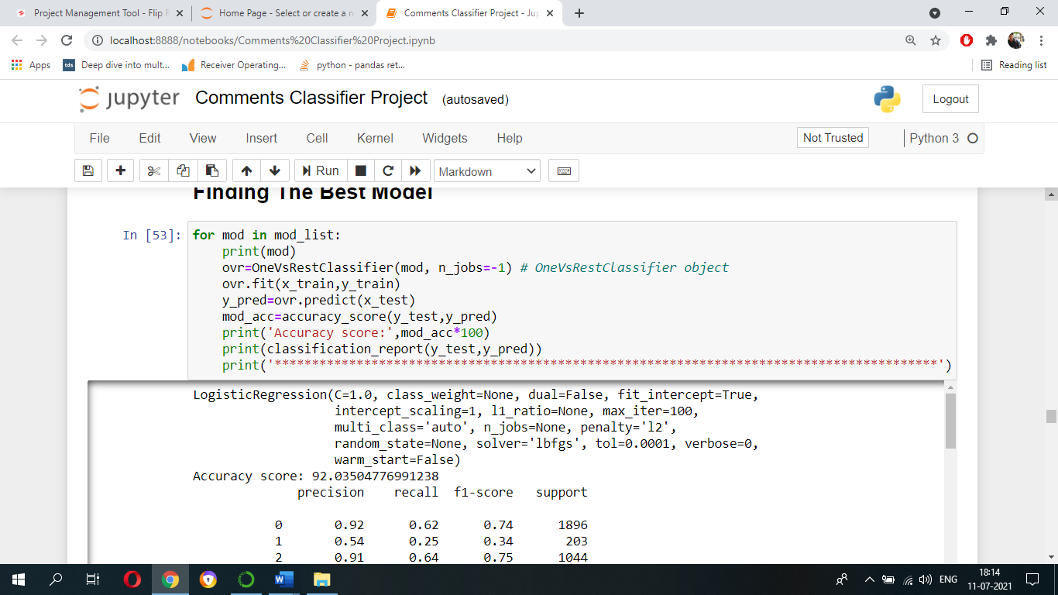
Finding The Best Model
Code For Finding The Best Model

Slide 27
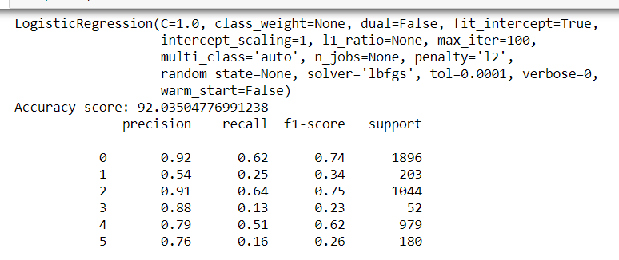
Algorithms Result
Logistic Regression

Slide 28
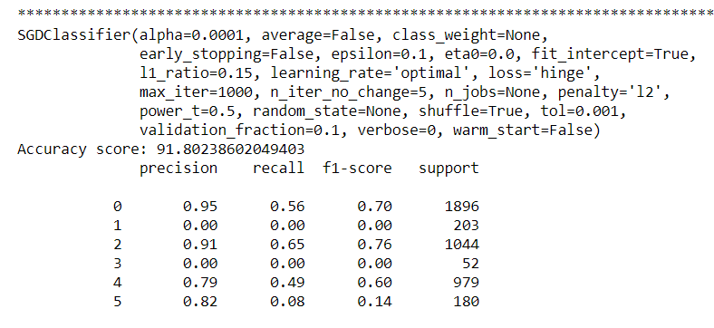
SGD Classifier

Slide 29
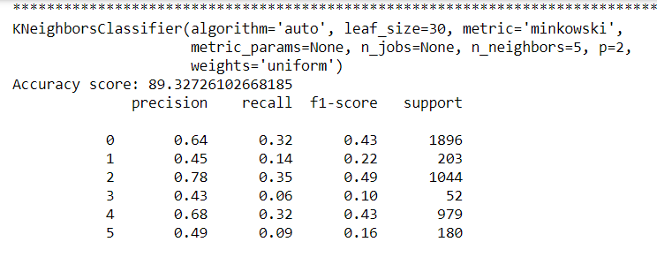
K Neighbors Classifier

Slide 30
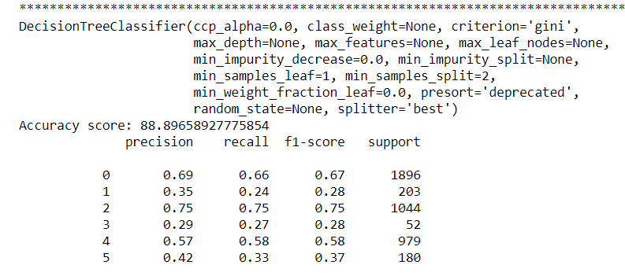
Decision Tree Classifier

Slide 31
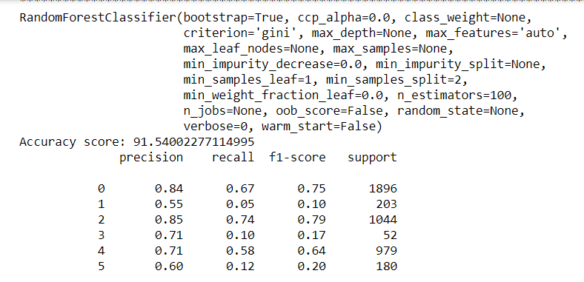
Random Forest Classifier

Slide 32
From the previous slides, we can conclude that ‘Logistic Regression’ model is performing better with an accuracy score of 92% to 94%.

Slide 33
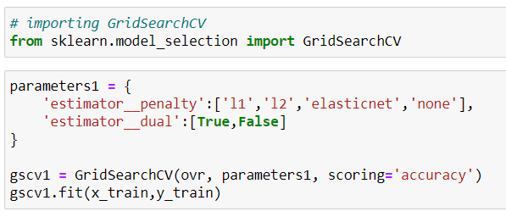
Hyper-Parameter Tuning

Slide 34
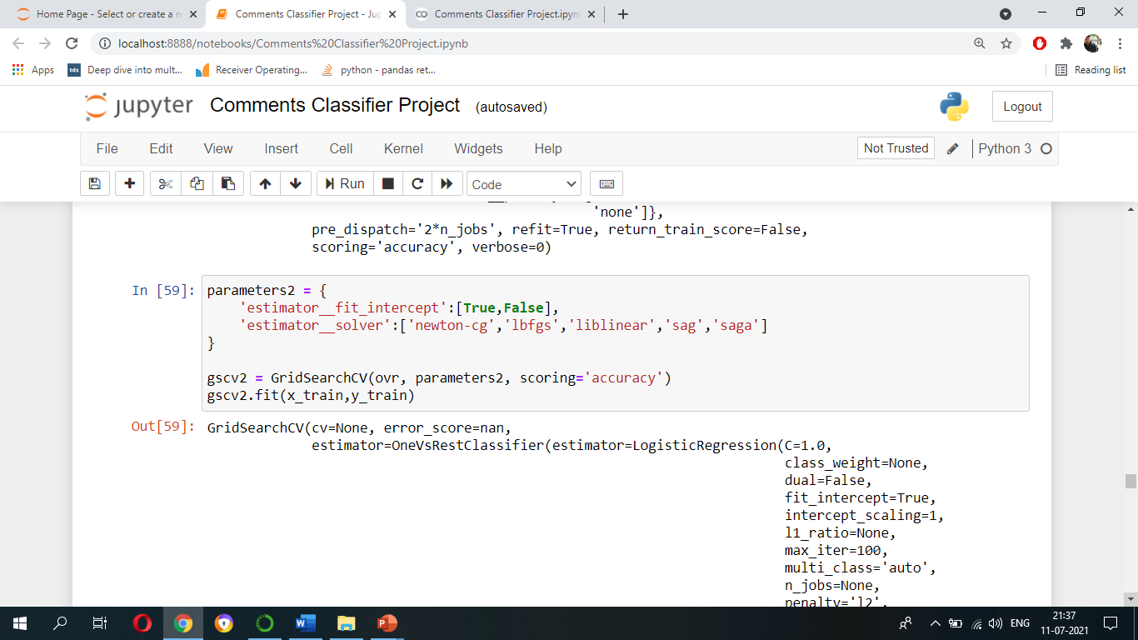

Slide 35
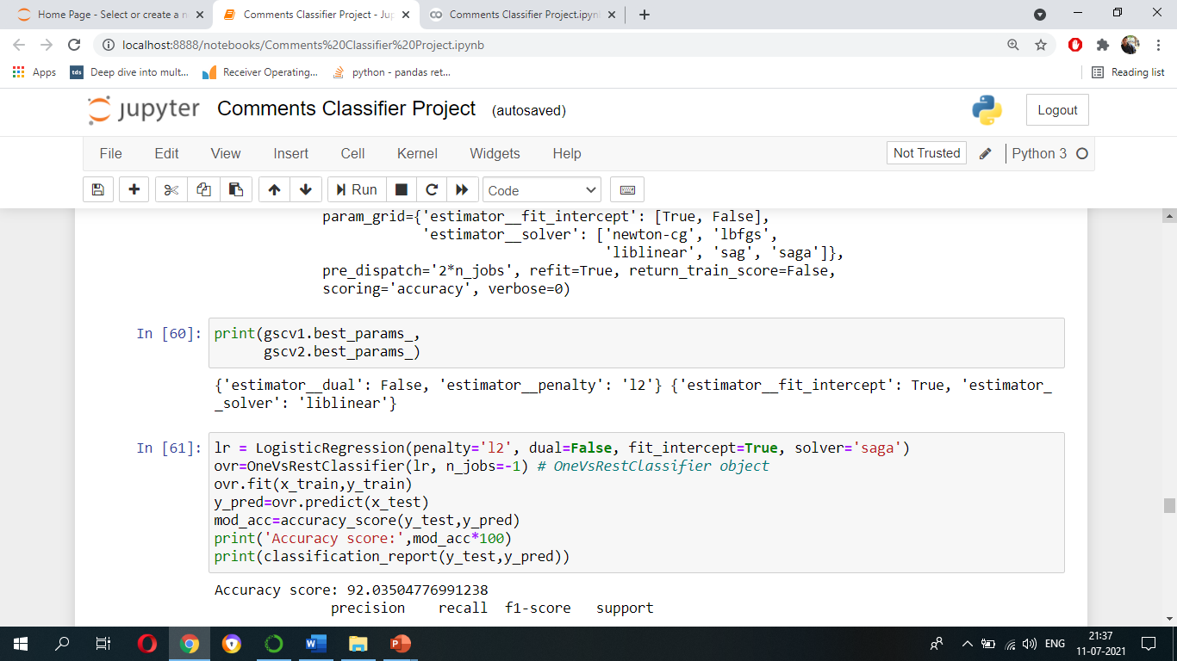

Slide 36
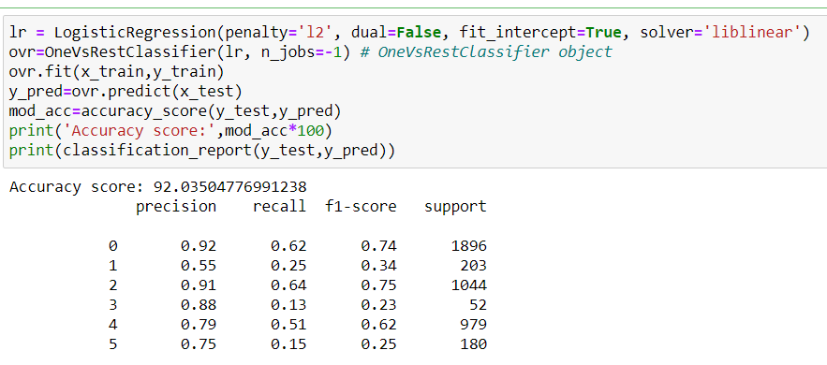

Slide 37
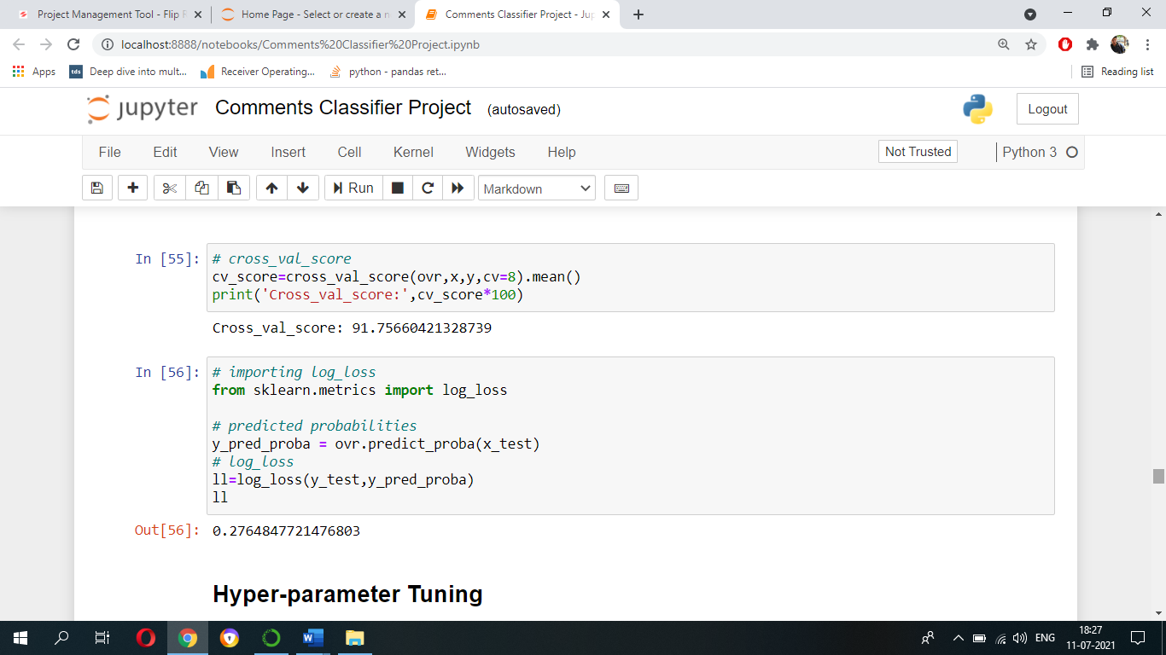
Cross_val_score

Slide 38
Log_Loss

Slide 39
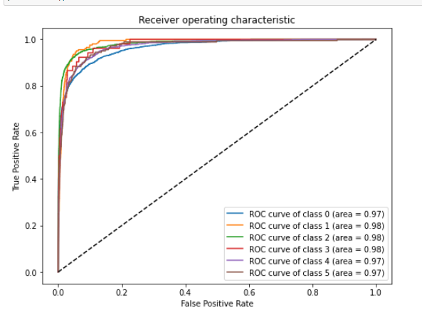
Roc Curve

Slide 40
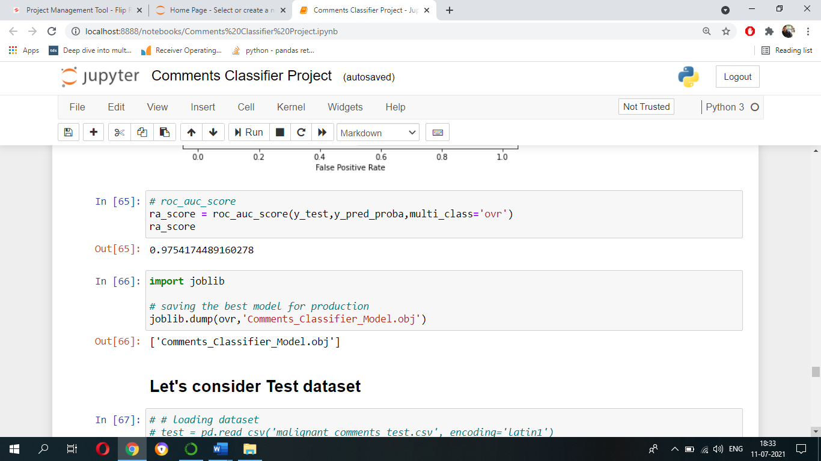
Roc-Auc Score

Slide 41
Conclusion
By looking at the cloud words generated for different classes we can conclude that some comments are offensive. Hence it should be controlled and restricted so that we can avoid spreading hatred and cyberbullying.
Among selected algorithms/models Logistic Regression model is performing better with an accuracy score of 92% to 94%. And finally, the Roc-Auc score is 0.97.

Slide 42
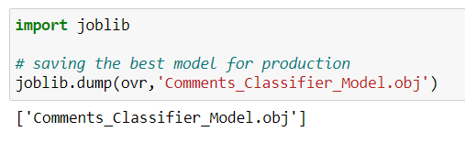
Saving the best model

Slide 43
Saving the best model

Slide 44
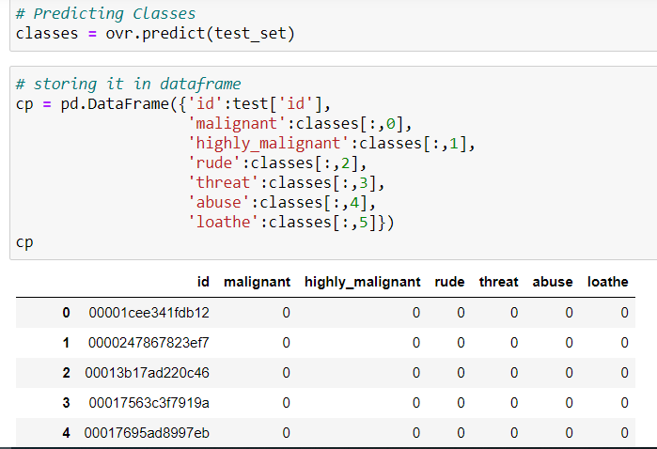
Predicting the Comments classes

Slide 45
Thank You

